Slide 1
Programming Assessment Presentation
Exploratory Analysis Based on the Auto Dataset

Slide 2
Introduction and Background
Data Source: Consumers Union, authorized by Consumer ReportsIt .
It includes attributes such as price, weight and origin (foreign).
Research objectives:
-- Explore the main factors affecting the price of cars.
-- Analyze the relationship between car weight and price.
-- Investigate the price differences between domestic and foreign cars.
And so on

Slide 3
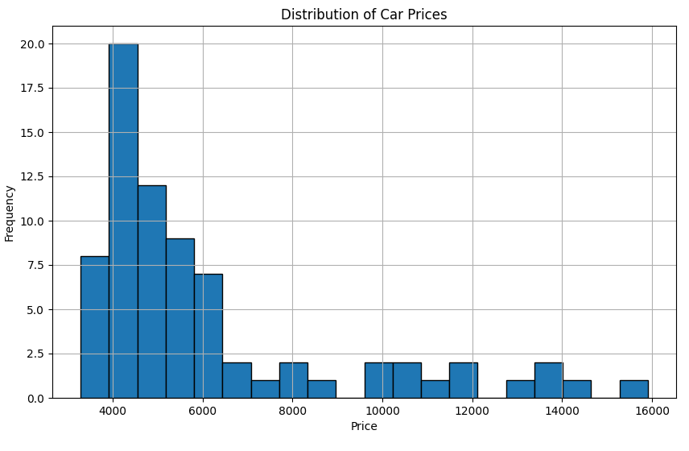
Univariate Data Exploratory Analysis - price
The data distribution is skewed to the right, and the price of most cars is relatively low (mainly concentrated in the 4000-6000 range). The number of higher-priced cars is gradually decreasing
In the price range of 4000 to 5000, the number of cars is the highest, reaching close to 20.The 5000 to 6000 price range also has a higher frequency, but is significantly lower than the 4000-5000 price range.There are very few cars priced over 10,000, and the distribution is gradually sparse, which may belong to high-end or special models.
This may reflect the dominance of mainstream economy cars. The number of cars above 10000 is small, probably high-end models, and the target customer group is more limited.

Slide 4
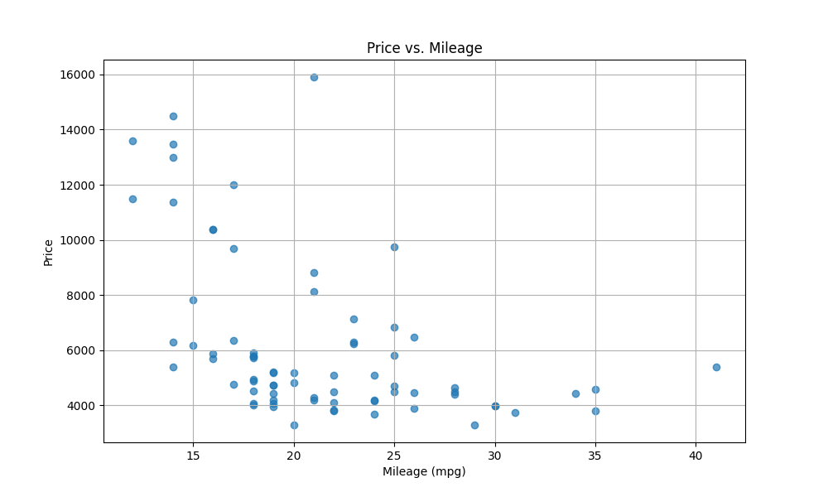
The relationship between variables and other variables
(Price and mileage)
Cars priced above 10,000 are mostly in the 15-20 mpg range. These cars may be high-end models (e.g., luxury cars, large SUVs) that are less fuel efficient. Fuel efficiency may have less of an impact on the price of these cars.
Most low-priced cars (priced below 6000) are distributed in the 20-35 mpg range: these cars are generally economy vehicles with high fuel efficiency.High fuel efficiency is a big selling point for affordable cars, which may be in line with the average consumer's needs.
Higher-priced vehicles are less fuel efficient, but consumers in this segment of the market may value brand or performance more than fuel economy.
Overall, the chart reveals the significant impact of fuel efficiency on prices, especially in the economy car market, where fuel efficiency can be an important driver of price.

Slide 5
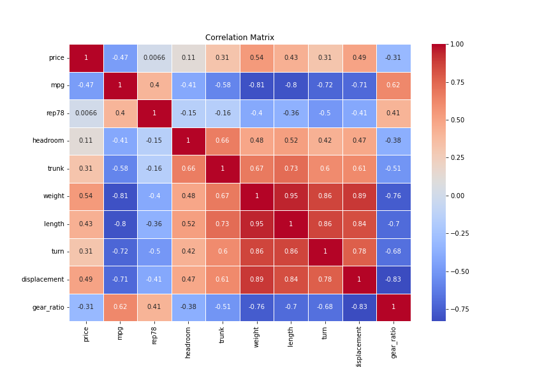
The relationship between variables and other variables
(Price and whether imported car)
This Correlation matrix shows the relationship between the price of a car and a number of performance indicators.
There is a significant positive correlation between price and weight (0.54) and displacement (0.49), indicating that heavier cars with larger displacement cost more. And price is negatively correlated with miles per mile (-0.47), reflecting the relatively lower price of more fuel-efficient vehicles.
Weight is positively correlated with length (0.95) and displacement (0.89) height, indicating that larger vehicles are less fuel efficient (-0.81). Turning radius is positively correlated with weight and length (both 0.86), indicating the handling limitations of larger vehicles.
On the whole, high-end cars are characterized by large weight, long size and high displacement, and pay attention to performance and comfort; Economy cars are lighter, more compact and fuel efficient, making them suitable for everyday use.

Slide 6
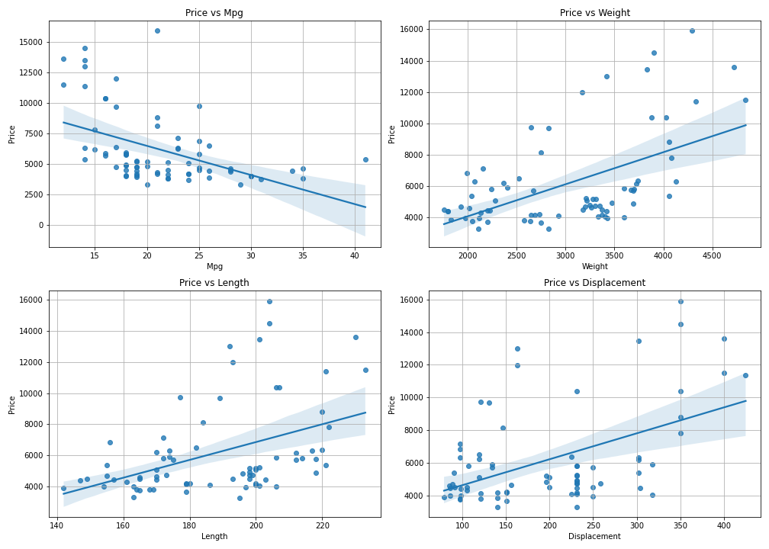
Price in relation to other variables
(scatter plot and regression analysis)
This set of scatter plots describes the linear relationship in depth through regression lines and confidence intervals, and focuses more on clarifying the trend and predictive power among variables than the previous plots.
For example, weight has a steeper regression line, showing a more significant impact on price, while length and displacement have a more flat impact. In addition, the price distribution of vehicles with higher fuel efficiency is more dense, while the price distribution of vehicles with larger weight and displacement is more dispersed.
This set of charts is characterized by providing trend, distribution, and uncertainty information simultaneously. It is especially suitable for analyzing the quantitative effect of a single variable on price.

Slide 7
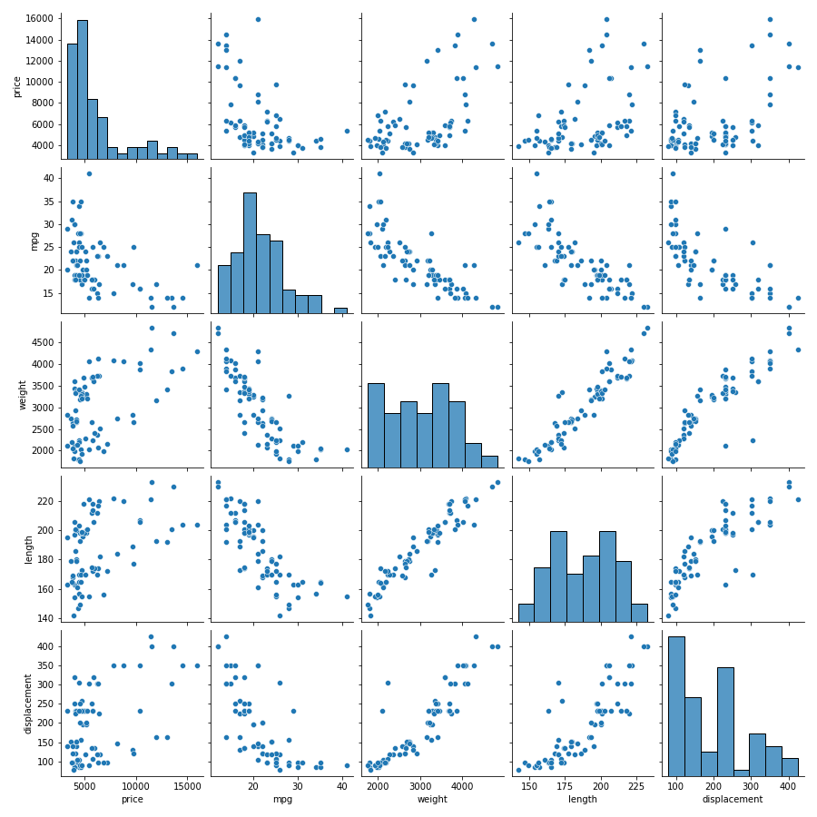
Pairwise diagram
This scatter plot visually reveals patterns and trends between variables by showing the distribution and pairwise relationships between variables.
The positive correlation between price and vehicle weight, vehicle length and displacement shows a linear distribution, while the negative correlation with fuel efficiency shows a significant downward trend, indicating that these vehicles cost more but fuel efficiency is lower.
There is a strong negative correlation between fuel efficiency, weight and displacement, and it is densely distributed and downward sloping, indicating that lightweight and small displacement are the key to improve fuel economy.
The scatter chart also highlights outliers, such as certain fuel-efficient but less expensive models. In contrast to a single correlation coefficient or heat map, a scatter matrix can simultaneously present the distribution of variables, correlation trends, and sample differences.

Slide 8
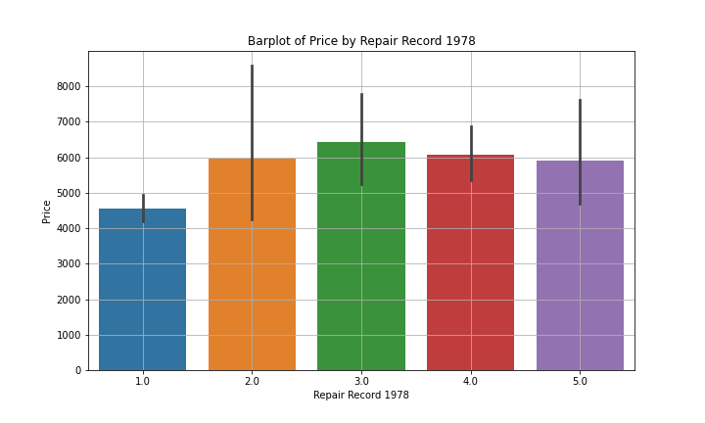
barplot of price by repair record 1978
This bar chart shows the average price of automobile groups and its price distribution range.
As maintenance records improve, the average price of a car fluctuates slightly rather than monotonously. Cars with a record of 3 cost the most, while cars with a record of 1 cost the least. Although the overall trend is not significant, cars with high maintenance records (4 and 5) cost slightly more than cars with low maintenance records (1 and 2).
The error lines indicate a wide range of price fluctuations for each set of data, especially for cars rated 2 and 3, which have a relatively wide range of price distributions, compared to cars rated 1 and 5, which have a more concentrated price distribution.

Slide 9
My difficulties and my solutions
Make sure the information is comprehensive and the chart is not cluttered when exploring relationships between multiple variables.
Use sns.regplot() to plot scatter plots and superimpose regression lines to visually show the linear relationship between variables.
Automatically adjust chart layout and spacing using Matplotlib's subplot (plt.subplot and plt.tight_layout).
When grouping statistics and price relationships, there may be missing values or outliers that affect the results.
Use sns.barplot() to draw a bar chart with error bars to clarify the mean differences of each group.For grouping missing values, aggregate the data with Pandas' pivot_table() and output it to validate the results.

